Slide 1
Smoo Holding Pte Ltd

Slide 2
ABOUT US
AR MEDIA HUB is an affordable mobile advertising media solution for SMEs, Retails & all Industry Trades through Augmented Reality (AR) Technology.
A new approach to businesses to help them create advertising campaigns of products and services with the use of Augmented Reality Technology. This technology is an innovative way to bring consumers in an interactive platform that is definitely much more fun to use.

Slide 3
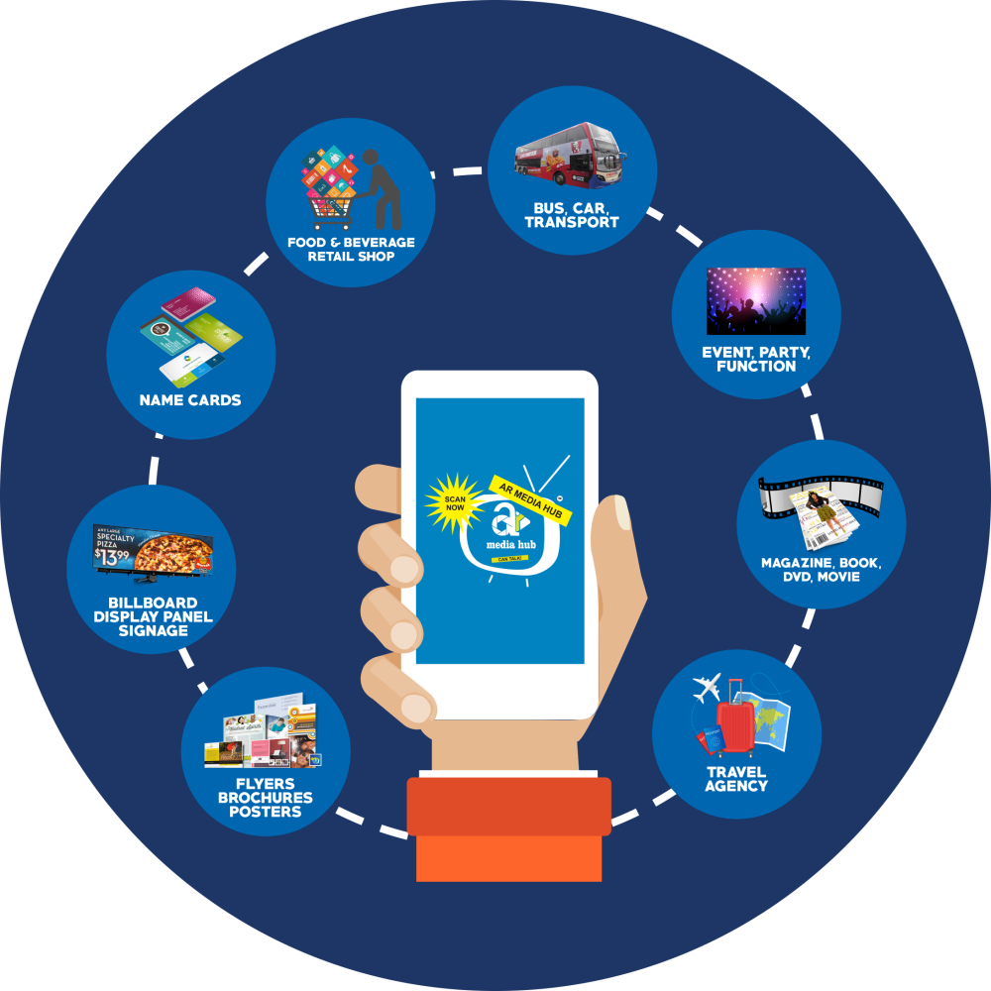
ABOUT US
AR MEDIA HUB presents a new approach to businesses to help Merchant create advertising campaigns of products and services with the use of Augmented Reality.
This technology is an innovative way to bring consumers in an interactive platform that is definitely much more fun to use.

Slide 4
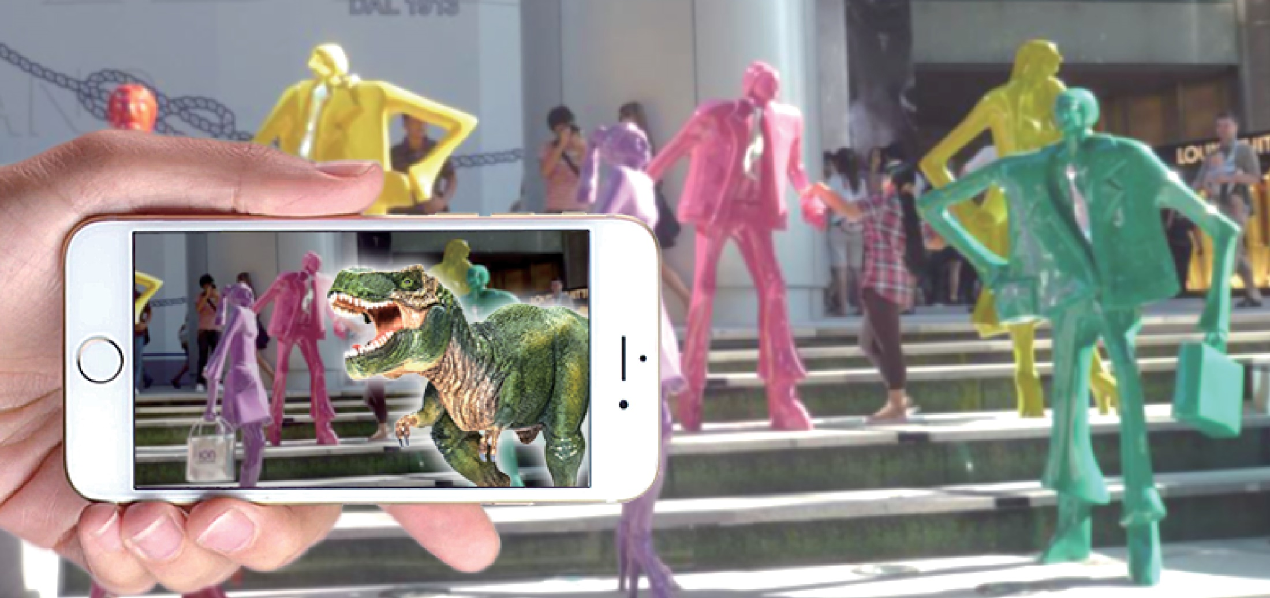
WHAT IS AUGMENTED REALITY (AR)?
Making a still picture become a reality through a smart phone.

Slide 5
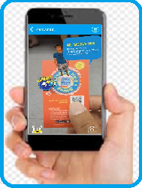
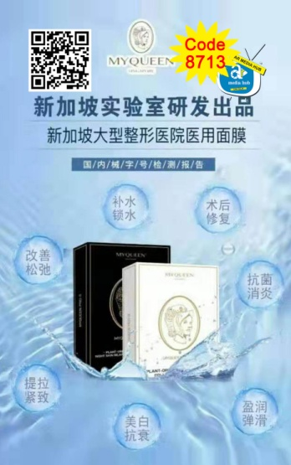
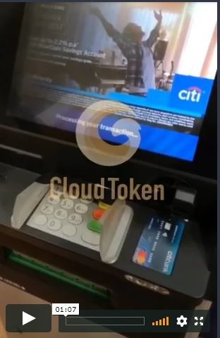
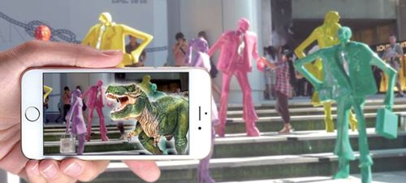
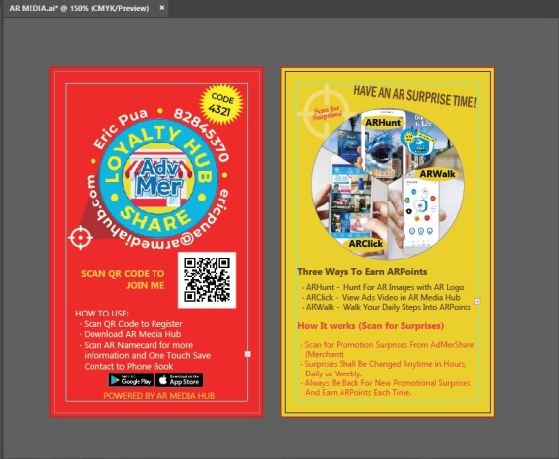
Showcase

Slide 6
MISSION
To empower businesses with the use of Augmented Reality Technology using a new advertising media platform - the AR Media Hub’s App.
We aim to provide creative ways for businesses to use which is interactive, futuristic and fun.

Slide 7
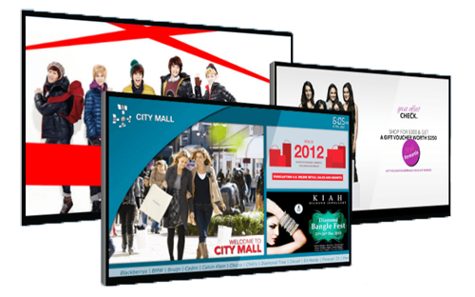
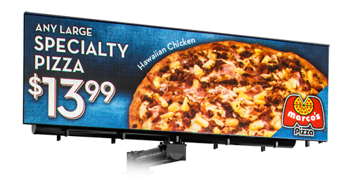
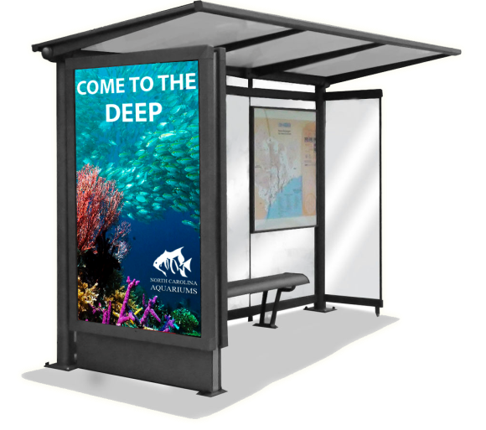
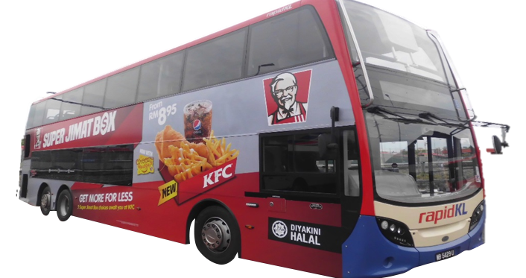
VISION
We aim to provide businesses with a much broader options to put their advertising content at a cheaper price and in an innovative way, We call it “AR Media Hub”. Businesses can put their content in many image materials such as vehicles, signboards, billboards, flyers, posters, name cards, membership cards, credit cards, logos, icon, banners, Grabcar/taxi, DVD covers, books, magazines, etc. These are all already going on in the market, what AR Media Hub provides is a Technology Concept that enhance their existing marketing materials. We can make the images Talking. "Can Talk" is our Company's AR slogan.

Slide 8
Goal
AR Media Hub (Smoo Holding Pte Ltd) aims to be recognised by the Advertising & Promotional industries as a needed enhancement in advertising & promotional service provider.
We shall spear head the market with our innovative ideas and assist the users (Merchants) to meet their sales target, build a regular royal customers and with our in-house IT continuously developing new technique and ideas.

Slide 9
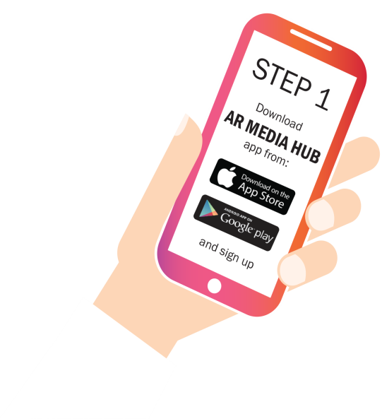
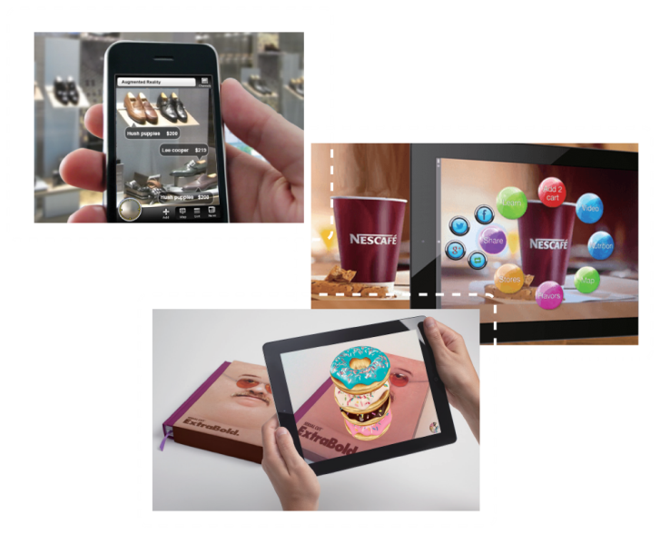
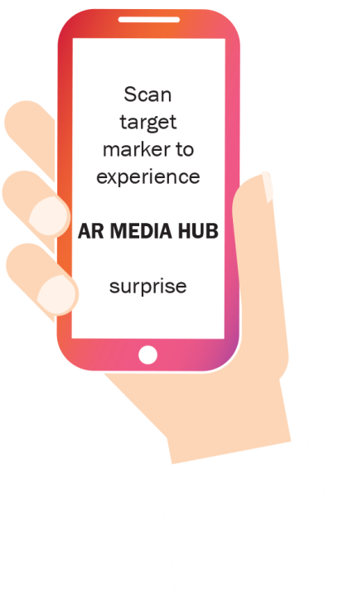
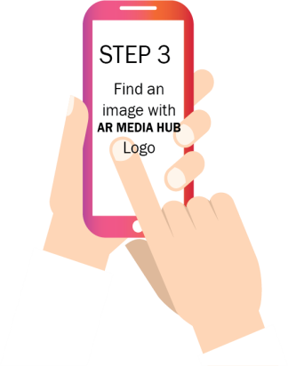
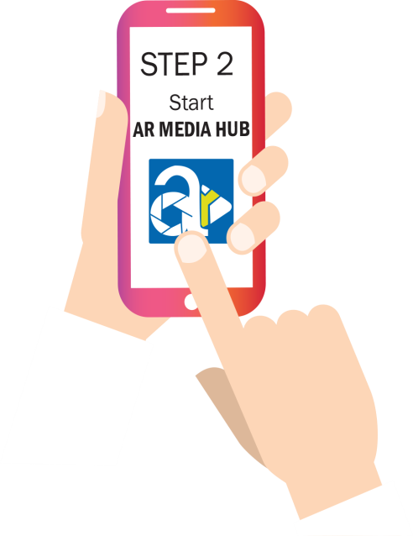
HOW IT WORKS
Free
DOWNLOAD THE APP:
Download the free app thru App Store or Play Store
Open AR Media Hub app
Find an image with AR Media Hub logo
Scan the image and experience AR Media Hub surprise!

Slide 10
HOW TO JOIN
Who can join AR Media Hub?
Anyone can join AR Media Hub by downloading the app and registering for free! This will make you a ‘Free User’ in our community and will enable you to scan and access unlimited AR experience and earn R(3.5) Points.
Free User shall only earn R(3.5) Points and shall be redeemed at Rebate 3.5 Shopping mall.
Upgraded User shall earn Cash and R(3.5) Points.

Slide 11
EARN & REDEEM
Collect R(3.5) Points to redeem many products and services from our partner merchants.
(Rebate 3.5)

Slide 12
Rewarding System
You can collect R(3.5) Points by referring a friend with our built-in referral system using social media.
R(3.5) Points will be earned once referred user finish viewing/scanning a 10 – 15 second AR through the app.
Each successful scan by user shall earn 0.25 R(3.5) Points while the direct referral shall earn 0.25 R(3.5) Points and upline of direct referral shall earn 0.25 R(3.5)Points.

Slide 13
Rewarding System
SCANNED AR | R(3.5) Points
Free User / BA | 0.25
Direct Sponsor | 0.25
Upline of DS | 0.25
Scan AR
2nd
0.25 R(3.5)
1st
0.25 R(3.5)
0.25 R(3.5)

Slide 14
Rewarding System
NEW USERS AND UPGRADES
Users can have as many referrals as they can. Each referral will earn R(3.5) points upon successful scanned of Merchant’s AR Marker. Which then can be used to redeem products and services at Rebate 3.5 (Loyalty Programme Platform).
Users can also upgrade their membership to our product package (SGD$199) as Business Ambassador and/or option (SGD$100) CRM (Customer Relation Management) program which gives rewarding compensation for promoting AR Media Hub ‘s products and services.

Slide 15
SERVICES
3 Types of Business Opportunity
1
AUGMENTED REALITY
ADVERTISEMENT
Business Ambassador
(3 AR Markers)
2
MERCHANT LOYALTY
Promotional Project
Customise AR Project
(Increase Sales/CRM)
Sharing A Business
Right Programme
Networks Building
(Be Rewarded )
3

Slide 16
Business Ambassador
Marker
Become an advertiser in AR Media Hub’s App and get access to an innovative way to reach your customers!

Slide 17
Merchants’ Customise AR Project
Promote Create innovative periodic promotional programme with our AR Media Hub’s App and become a professional Advertising and Promotional Sale’s person earning a regular income. (5 to 10% commission)

Slide 18
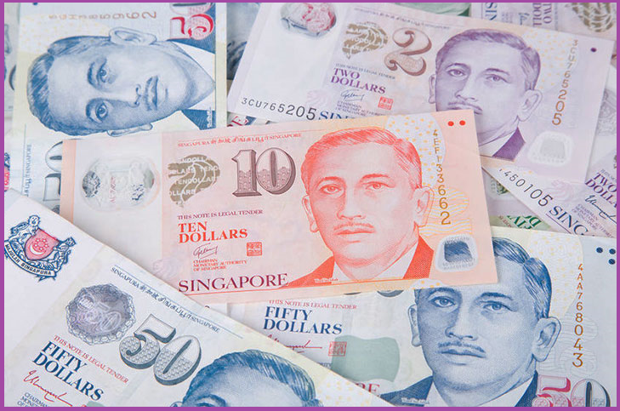
Network Building
Easy to build a strong networks.
Two Unique reward payout plans
Products and Services - easy to sell and is viral
(2 Tiers Payout – 10% / 5%)
3. Highest payout commission – 73% payout

Slide 19
PACKAGE
Introducing
AR Media Hub’s
Business Ambassador
PROGRAM

Slide 20
Be A Business Ambassador
(SGD$199 for 12 Months Subscription)
Option : SGD$100 for CRM program
Benefits:
Advertisers (Business Ambassador) can host 3 Markers in their campaigns in AR Media Hub’s app for minimum of 12 months.
Market to prospect s– Customise AR promotion to Merchants/Retailers @ 5 to 15% commission
Option : CRM – A SGD$30 credits shall be added into BA’s account for Scanners credit earned. (Top up Scanning AR’s Credit when is low)
Notes:
An advertiser (BA) needs to provide one marker and advertisement video of 10 - 15 seconds in MP4 format.
Advertisers (BA) buy credit - R(3.5)Points, so Free Users and BA can claim R(3.5)Points upon scanning of AR image when credit is low
20% of earning from Business Ambassador shall be converted to R(3.5) Points.

Slide 21
Merchant’s AR Campaign
(SGD$299 for 12 Months Subscription)
Inclusive of CRM program & AR Scanning Top up of SGD$30
Benefits:
Advertisers (Merchants / Retailers) can host 6 AR Markers in their campaigns in AR Media Hub’s app for a yearly subscription.
CRM – A SGD$30 credits shall be added into Merchant’s account for Scanners credit earned. (Top up Scanning AR’s Credit when is low)
Notes:
An advertiser (Merchants / Retailers) needs to provide one marker (max 10mb) and advertisement video of 10 - 15 seconds in MP4 (max 80mb) format for each Marker
Advertisers (Merchants / Retailers) buy credit - R(3.5)Points, so Free Users and BA can claim R(3.5)Points upon scanning of AR Markers.

Slide 22
Customer Relation Management
Additional Benefits (Back-end Office)
Optional to Business Ambassador (SGD$100)
Access to full service back-end tracking & reporting of scans
Access to statistics and analytics tools to help understand user behaviour and purchased history (CRM)
Push Notification Services – Push promotional / marketing project via Mobile App (Back- End-Office) to targeted users
Access to the data of CUSTOMERS captured in CRM for future promotional & marketing purposes.
Notes:
A SGD$30 Scanning AR credits shall be added into BA’s account
Top up is needed when credit is low

Slide 23
What is AR Action Button
AR Action Buttons – targeted for calling an action
Upon scanning the AR Markers, an action button will pop up. Tap for your desired action.

Slide 24
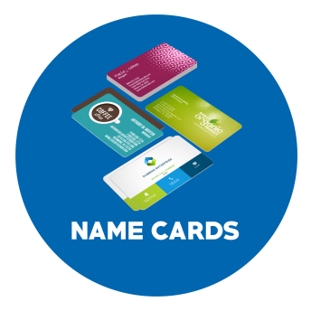
Who needs AR Advertising
We cater a wide range of trades & industries where you can showcase your AR campaigns
Notes:
Trades and industries are unlimited and no boundary of business prospects

Slide 25
AR Media Hub
Put your business in AR Media Hub and have more customers to view your products and services to drive more sales.

Slide 26
AR Media Hub
AR Media Hub
LOYALTY REDEMPTION

Slide 27
Loyalty Program
2 Ways to accumulate R(3.5) Points :
Scanning Merchants’ AR Markers
By Sharing - Total Earnings of 20%
shall be converted to R(3.5) Points
Benefits:
R(3.5) Points will be accumulated from Free Users and Business Ambassador. These points can be redeemed at
Rebate 3.5’s participating merchants.
Note : Visit https://rebate35.com

Slide 28
On-Going Promotional Activities
Bonus Activities :
Each BA and Merchant package will contribute SGD$5 to Bonus Fund
Our collected “Bonus Fund*” will be used for Daily Lucky Draw and will be given randomly to scanners
Example:
*Bonus of 10, 50 or 100 R(3.5) Points will be given away to a lucky scanner using a standard algorithm from AR Media Hub ‘s app platform

Slide 29
+65 93707255 / +65 91076086
Smoo Holding Pte Ltd
Reg. no : 202238873z

